Slide 1

The vital role of Volunteers

Slide 2
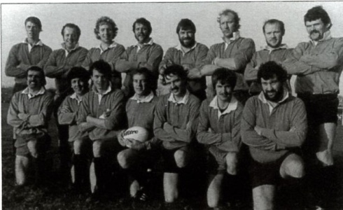
Where have we been?

Slide 3
President
Safeguarding
Mini Chairperson
1st Team Captain
Chairperson
Director of Rugby
Treasurer
Secretary
Vice Chairperson
Junior Chairperson
Ladies Representative
Lead First Aid Officer
Director of Coaching
Vacant
Volunteer Coordinator
Youth Registrar
School Liaison
Membership Secretary
Senior Registrar
Vice President Coordinator
Data Officer
Club
Minis Senior Leadership Team
International Fixtures Secretary
Publicity Secretary
Fixtures Secretary
Referee Coordinator
Senior Kit Secretary
Webmaster
Digital Communication Officer
Fixture Book Secretary
Head Coach to Seniors Men’s Teams
Social Secretary Vacant

Slide 4
Mini Chair Team
Under 4s & 5s
Under 6s
Under 7s
Under 8s
Under 9s
Under 10s
Under 11s
Coach
Coach
Coordinator
First Aider
Coach
Coach
Coordinator
First Aider
Vacant
Coach
Coach
Coordinator
First Aider
Vacant
Coach
Coach
Coordinator
First Aider
Coach
Coach
Coordinator
First Aider
Coach
Coach
Coordinator
First Aider
Coach
Coach
Coordinator
First Aider
Coach
Coach
Coach
Coach
Coach
Coach
Under 12s
Coach
Vacant
Coach
Vacant
Coach
Vacant
Coordinator
First Aider
Coach
Coach

Slide 5
Junior Chairperson
Under 13s
Under 14s
Under 15s
Under 16s
Colts
Coach
Coach
Coordinator
First Aider
Coach
Coach
Coordinator
First Aider
Coach
Coach
Coordinator
First Aider
Coach
Coach
Coordinator
First Aider
Coach
Coach
Coordinator
First Aider

Slide 6
Men's 1st XV
Head Coach
Manager
Captain
Men's 2nd XV
Head Coach
Manager
Captain
Women’s
Head Coach
Manager
Captain

Slide 7
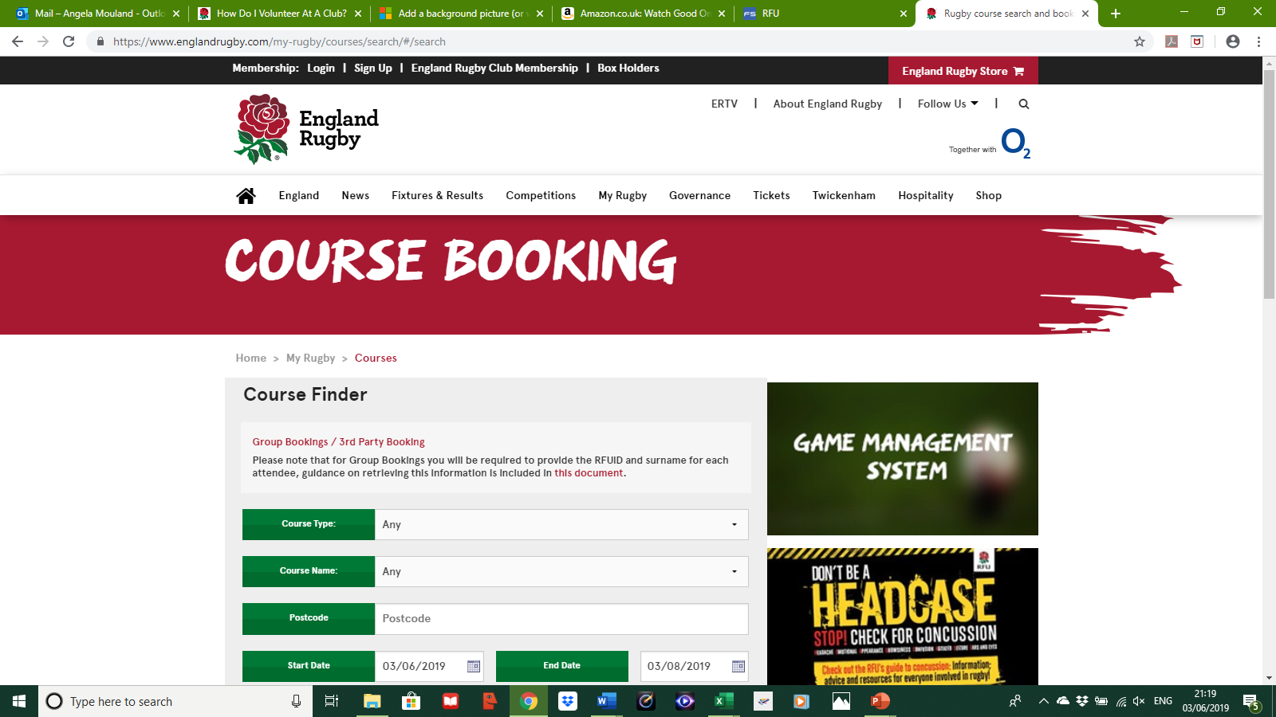
RFU Courses

Slide 8
Why Volunteer?
Gain confidence.
Meet people.
Make a difference.
Be part of a community.
Learn new skills.
Take on a challenge.
Have fun!

Slide 9

So, you think you might be interested in volunteering for Fordingbridge Rugby Club……
What skills and attributes are we looking for?
ENTHUSIASM!!!!
What time commitment is involved?
This may vary depending on the role. A minimum of 2 hours a week, but if you have more time, we can fill it!
What happens next?
DBS check
RFU’s Play It Safe Safeguarding Course – 3 hrs
On-line HEADCASE course

Slide 10
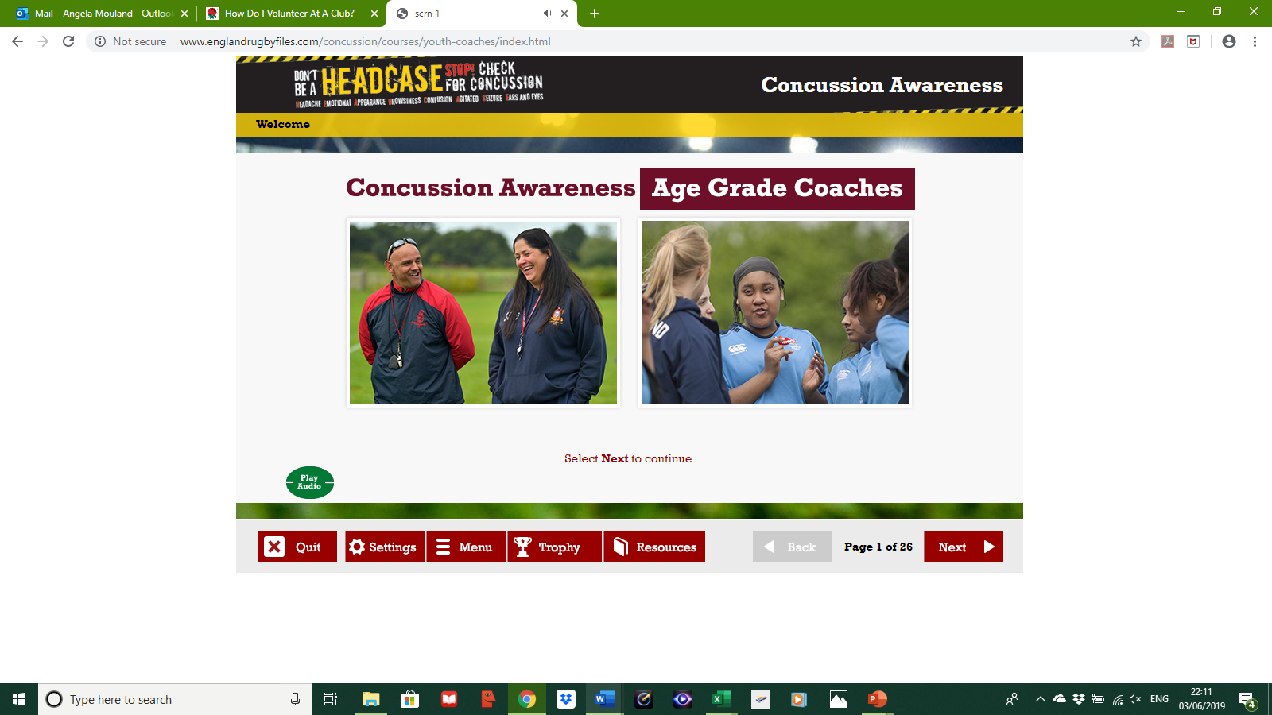
HEADCASE

Slide 11
One Club Your Club

